Slide 1


Slide 2
Rouge

Slide 3


Slide 4
Violet

Slide 5


Slide 6
Chat

Slide 7
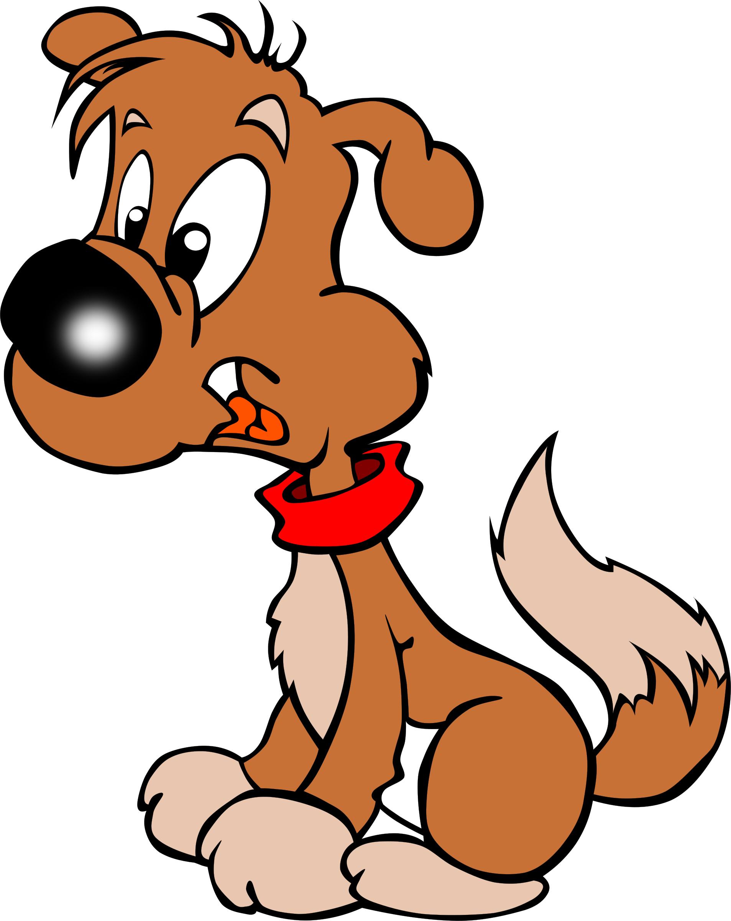

Slide 8
Chien

Slide 9


Slide 10
Orange

Slide 11
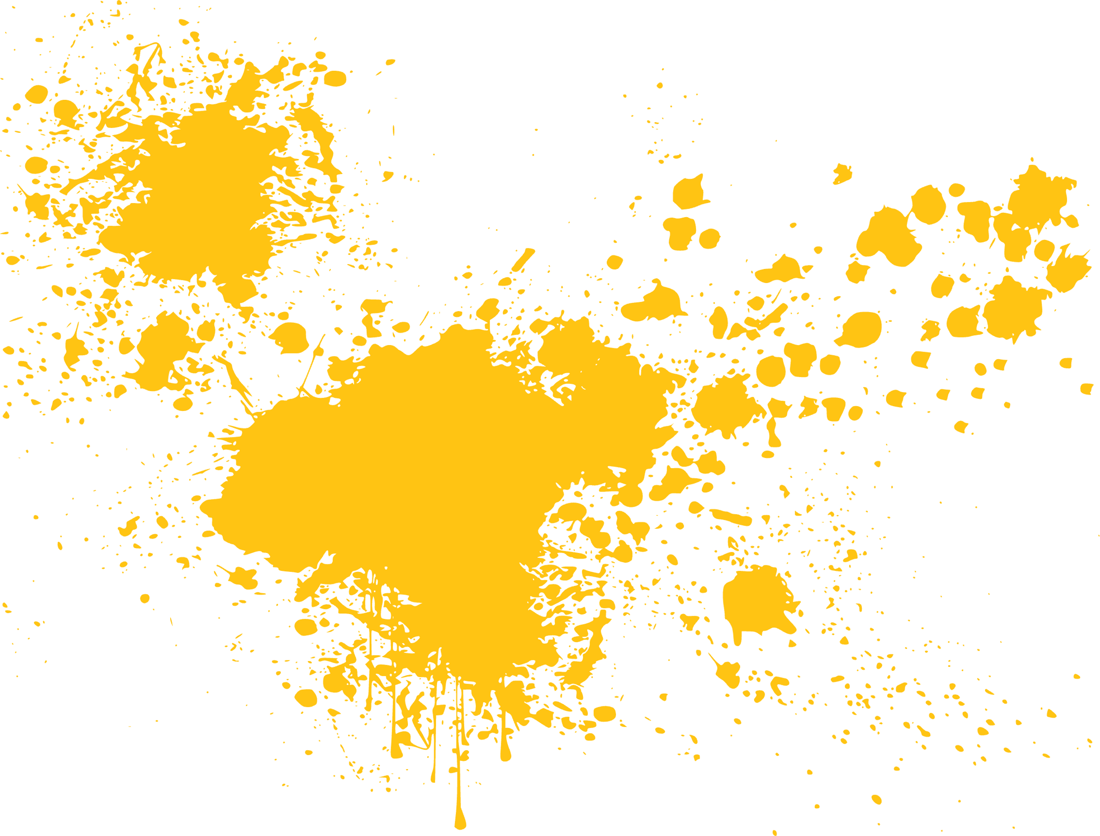

Slide 12
Jaune

Slide 13


Slide 14
Vert

Slide 15


Slide 16
bleu

Slide 17
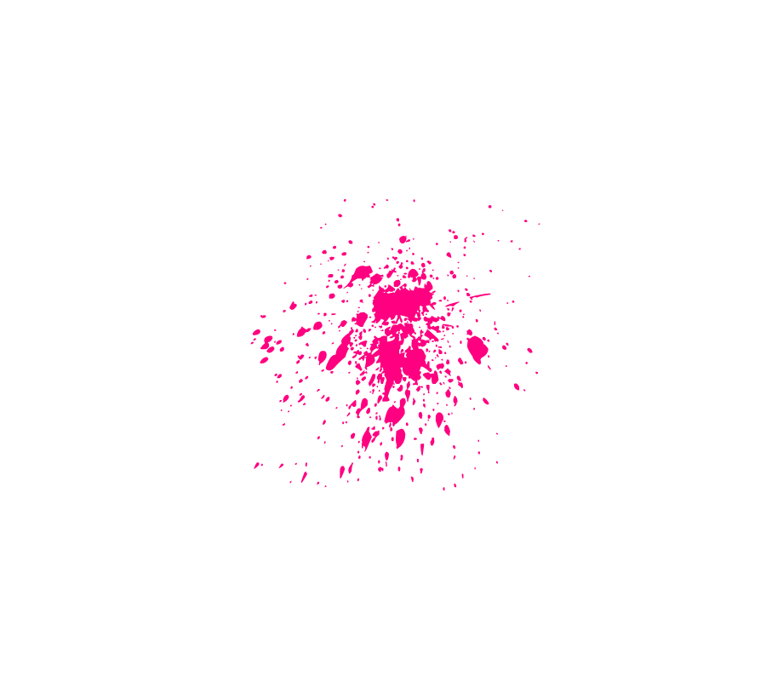
This Photo by Unknown Author is licensed under CC BY-NC

Slide 18







Slide 19
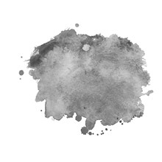

Slide 20

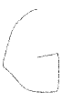

Slide 21


Slide 22

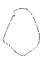
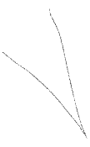


Slide 23


Slide 24






Slide 25
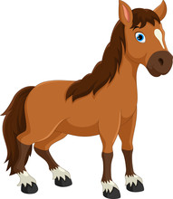

Slide 26
Cheval

Slide 27
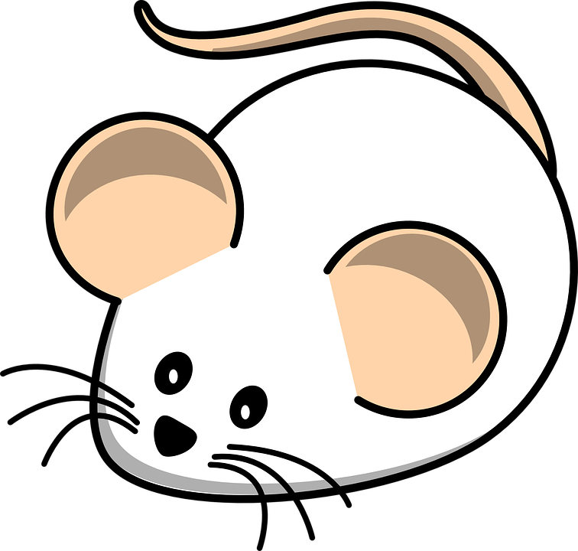

Slide 28
Souris

Slide 29
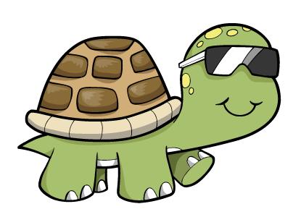

Slide 30







Slide 31
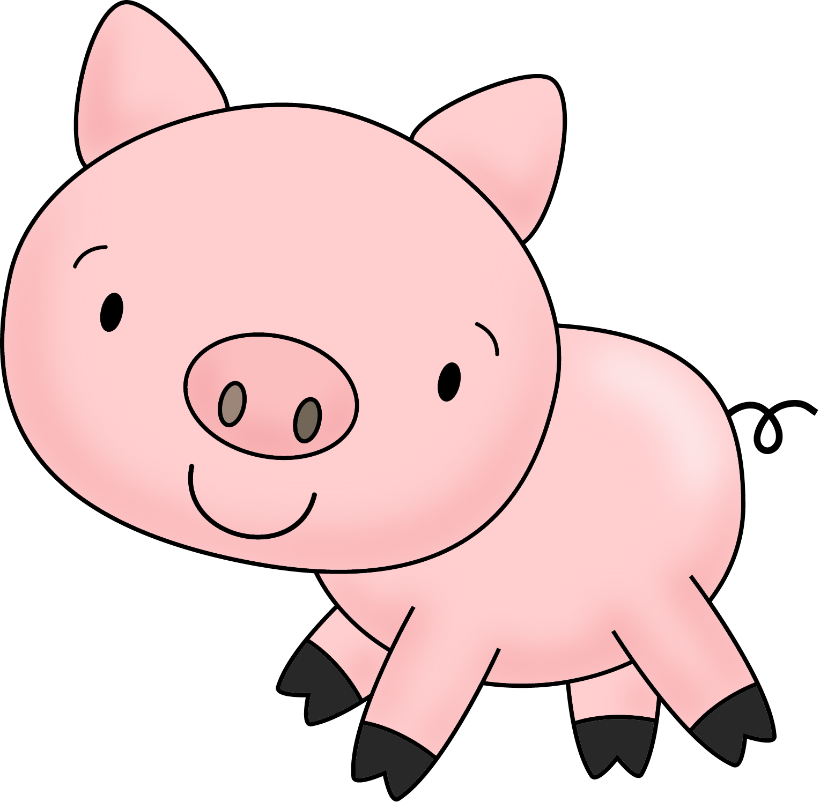

Slide 32
Cochon

Slide 33


Slide 34












Slide 35


Slide 36
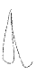
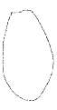





Slide 37
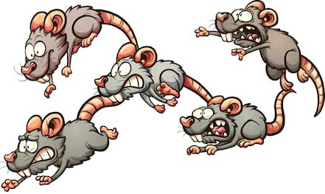

Slide 38
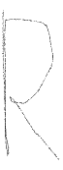




Slide 39
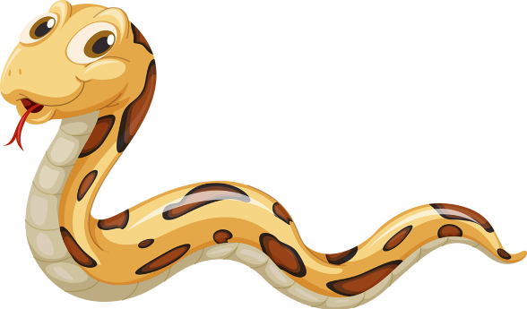

Slide 40
Serpent

Slide 41
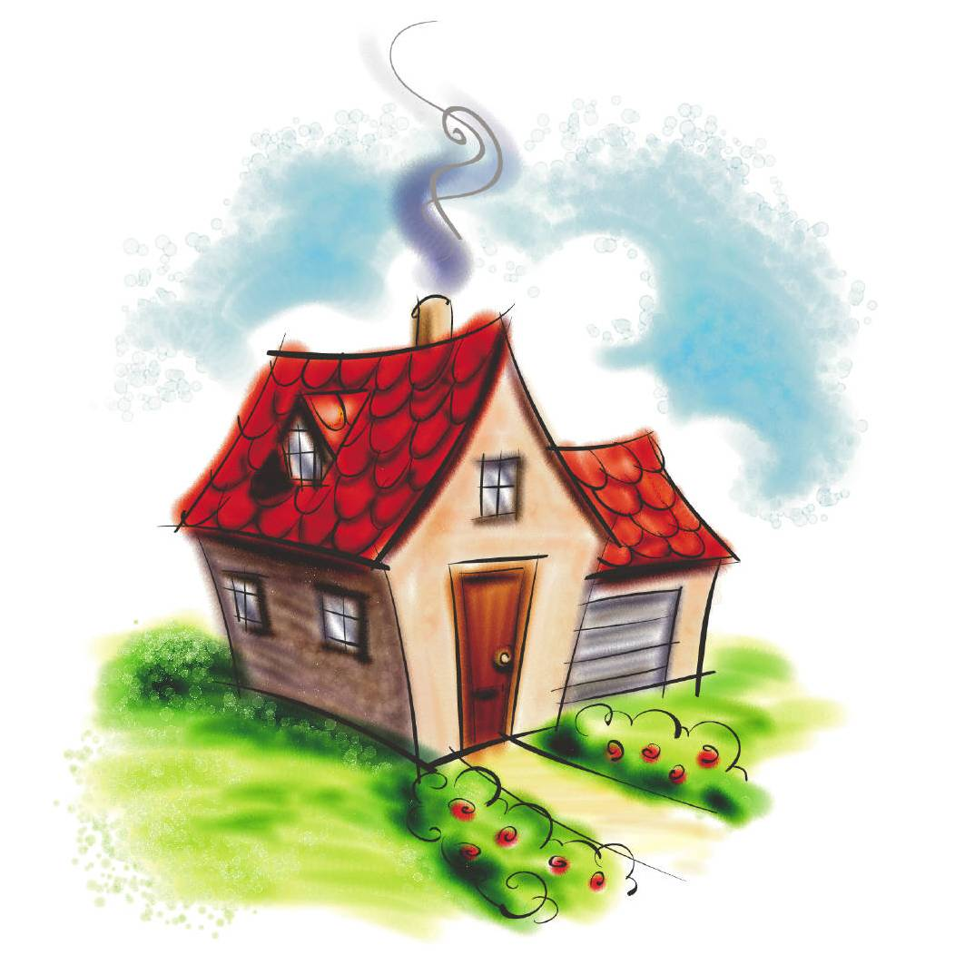

Slide 42
Maison

Slide 43
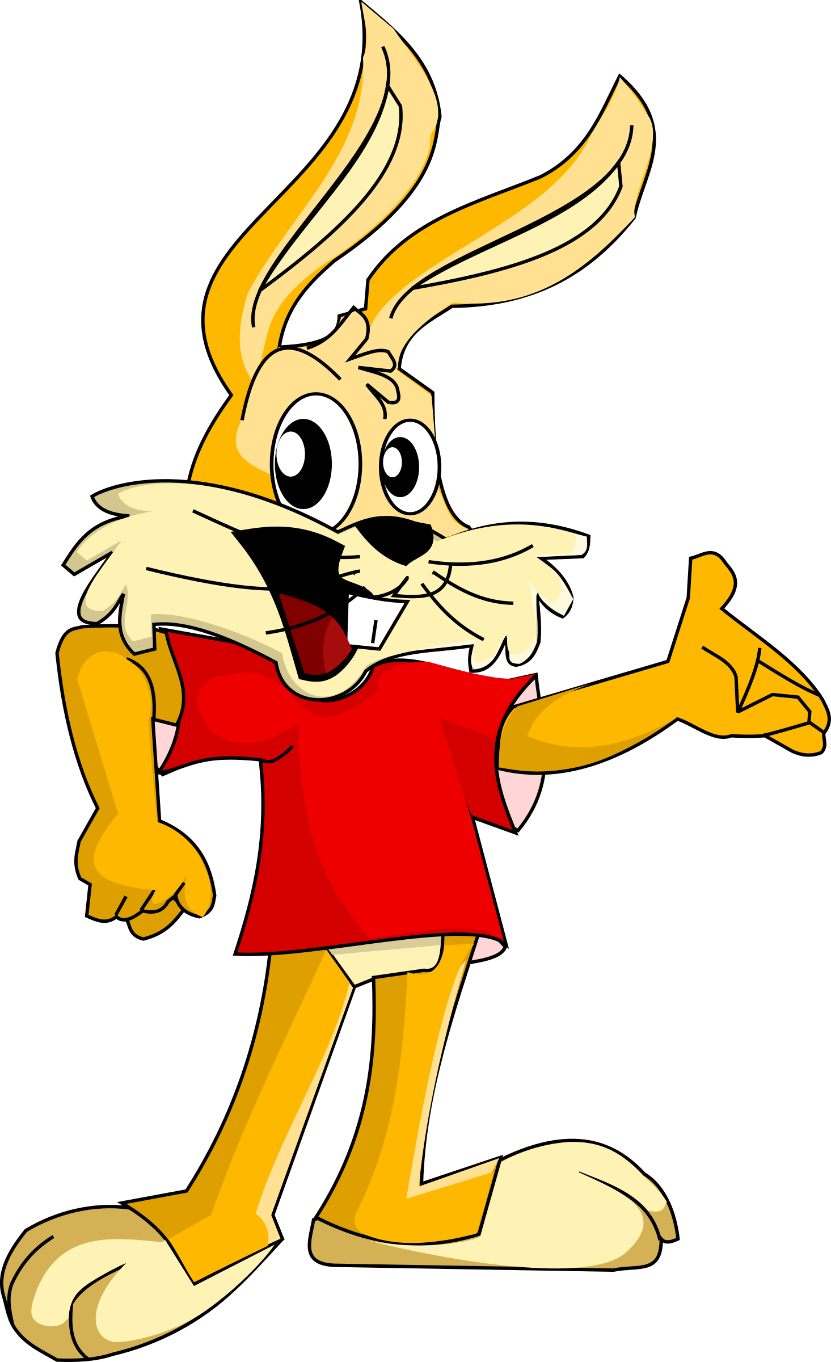

Slide 44
Lapin

Slide 45
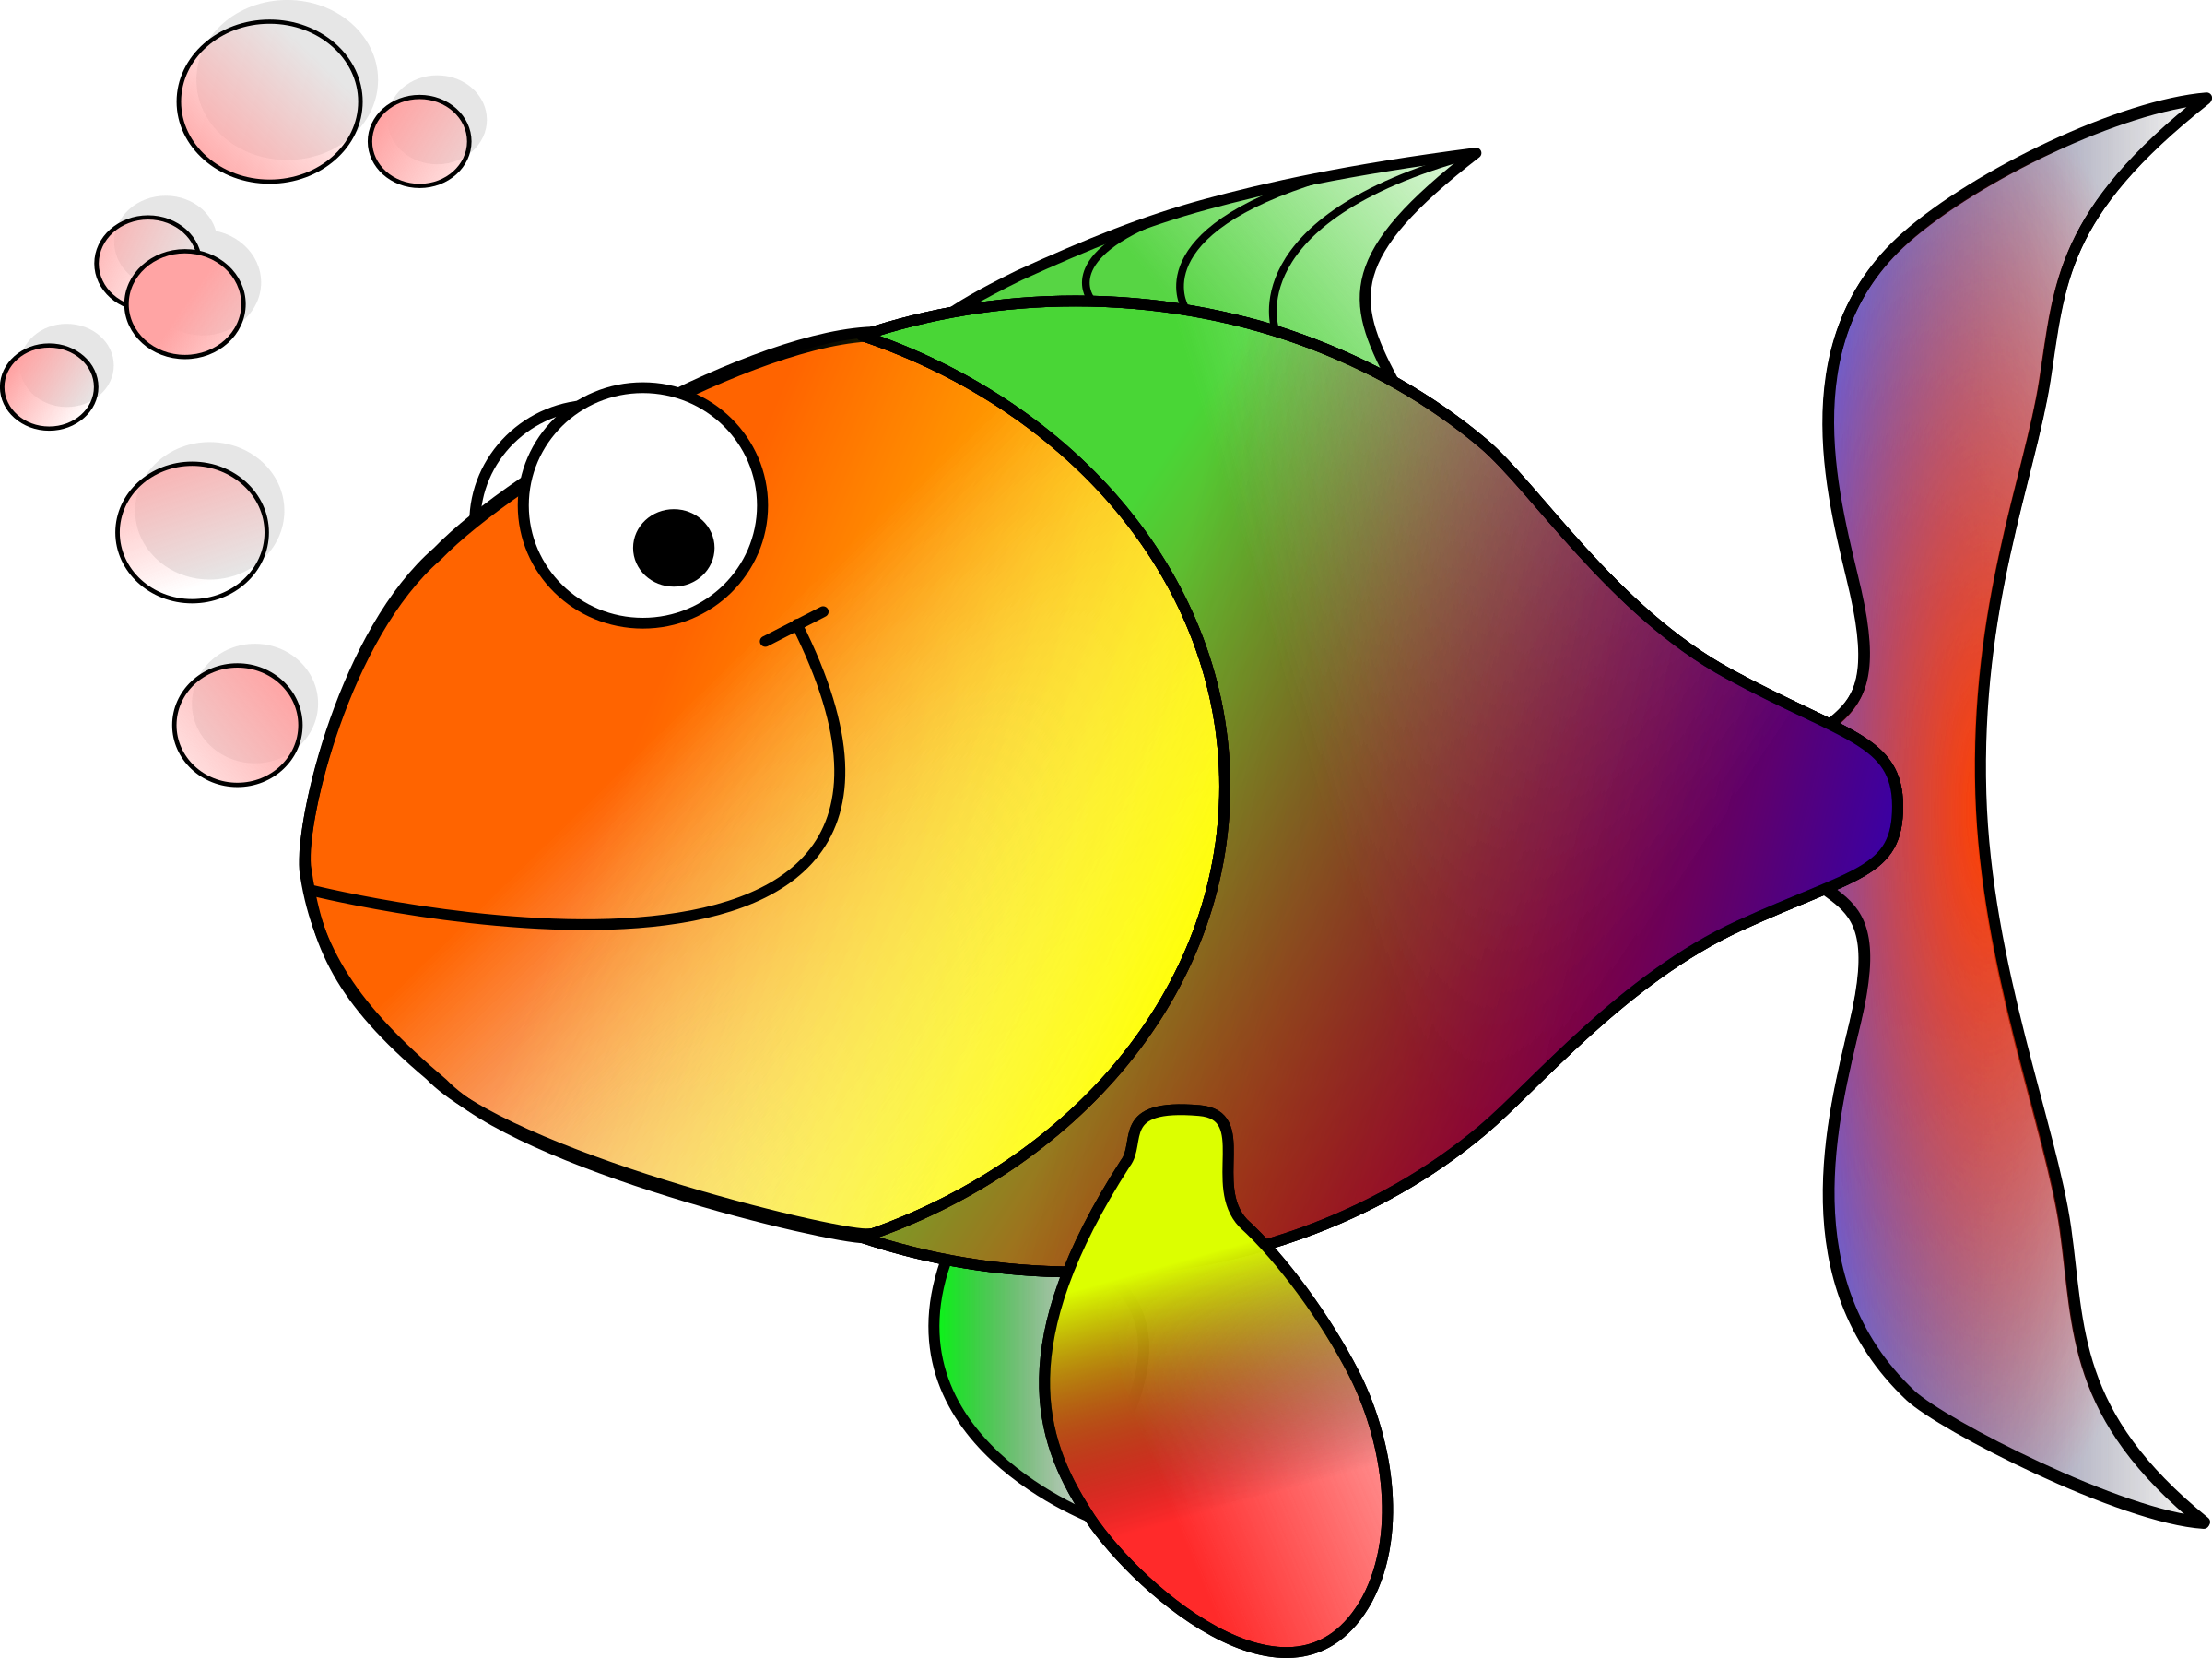

Slide 46
Poisson

Slide 47


Slide 48










Slide 49


Slide 50
Pomme

Slide 51


Slide 52






Slide 53


Slide 54
Banane

Slide 55
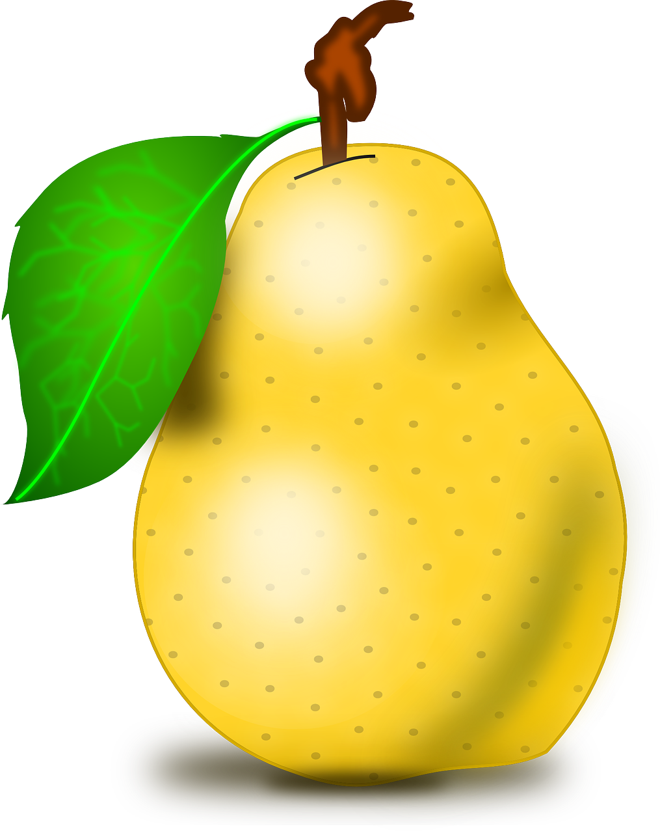

Slide 56






Slide 57
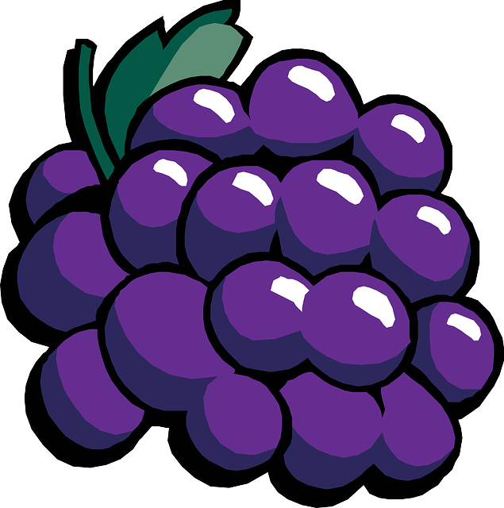

Slide 58
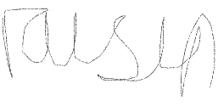

Slide 59


Slide 60
Prune

Slide 61
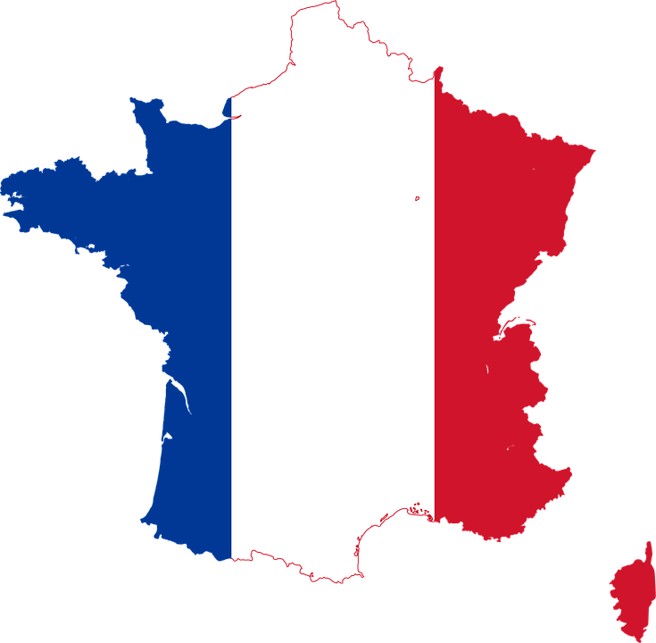

Slide 62
FRANCAIS!

